Slide 1


Presented By: Rejey Ezekiel (2348935)
Stock Price Forecasting -
CA3
AI and Machine Learning ST1511

Slide 2
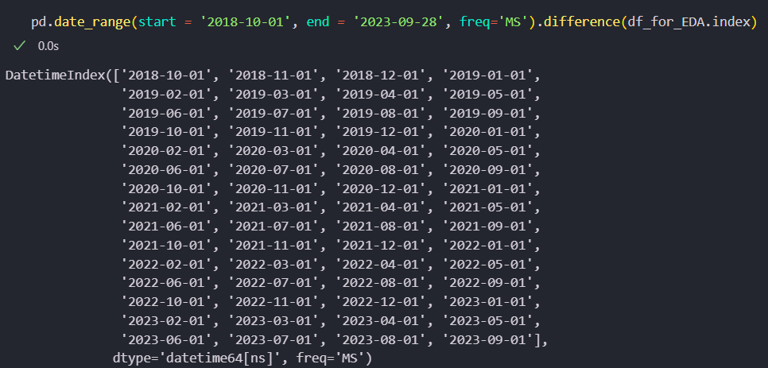
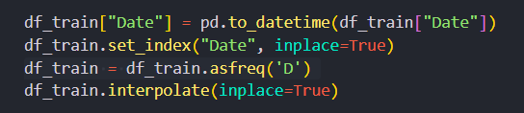
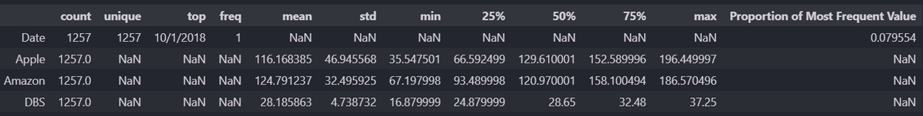
Stock Price Date Difference
Background
Our data set consisted of missing dates which is consistent with the stock market.
To deal with this i resampled my dataset to daily frequnecy.
i then interpolated the missing values it created.

Slide 3


Exploratory Data Analysis

Slide 4
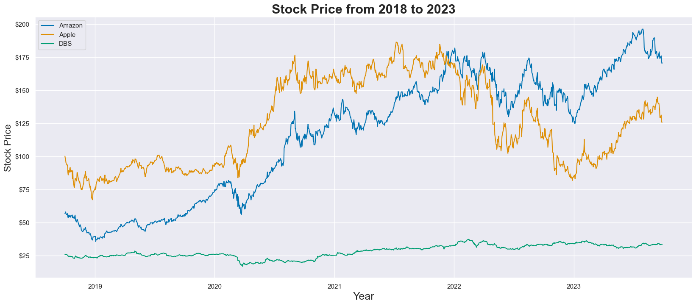
Trend of Stock Price
Details About Stock Price
All stocks show a general trend of positive growth.
Stock prices are from 2018-10-01 to 2023-09-28

Slide 5
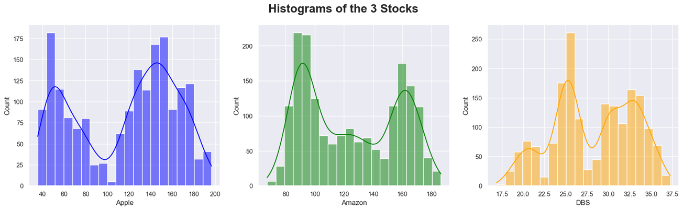
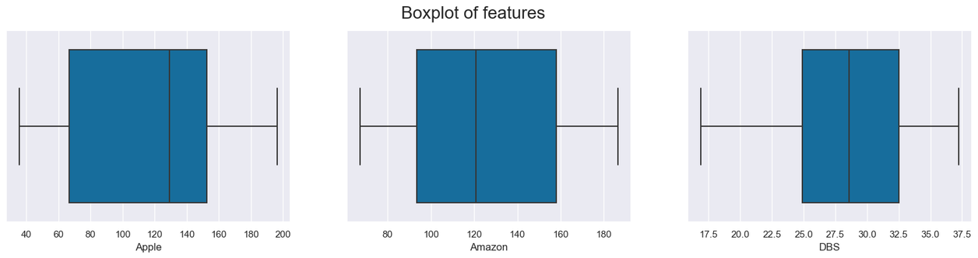
Distribution of the 3 Stocks
The histogram shows that the highest frequency for Apple, Amazon and DBS is 50, 90 and 22.5 dollars.
With all showing no normal distribution, having either a positive or negative skew

Slide 6
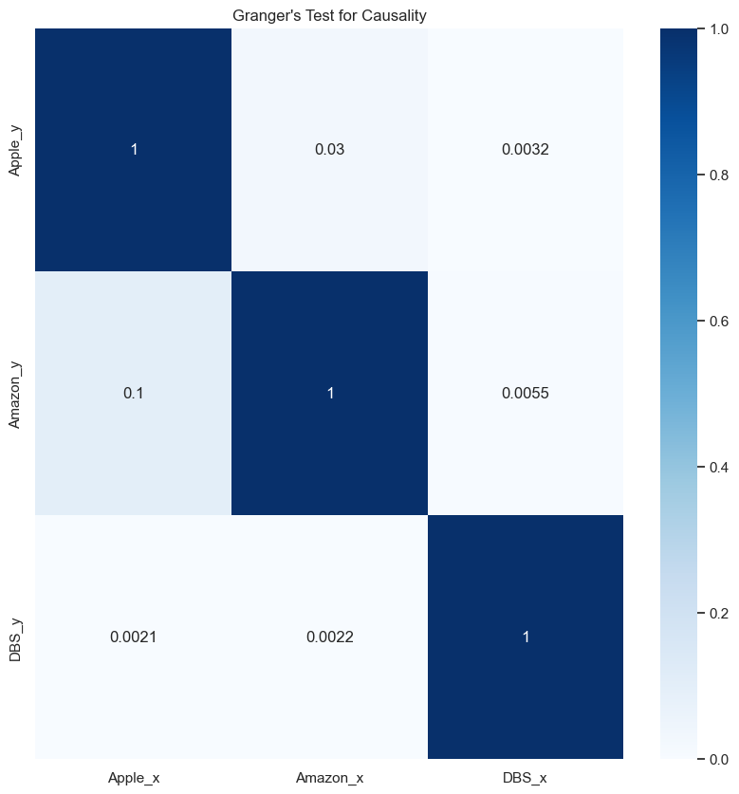
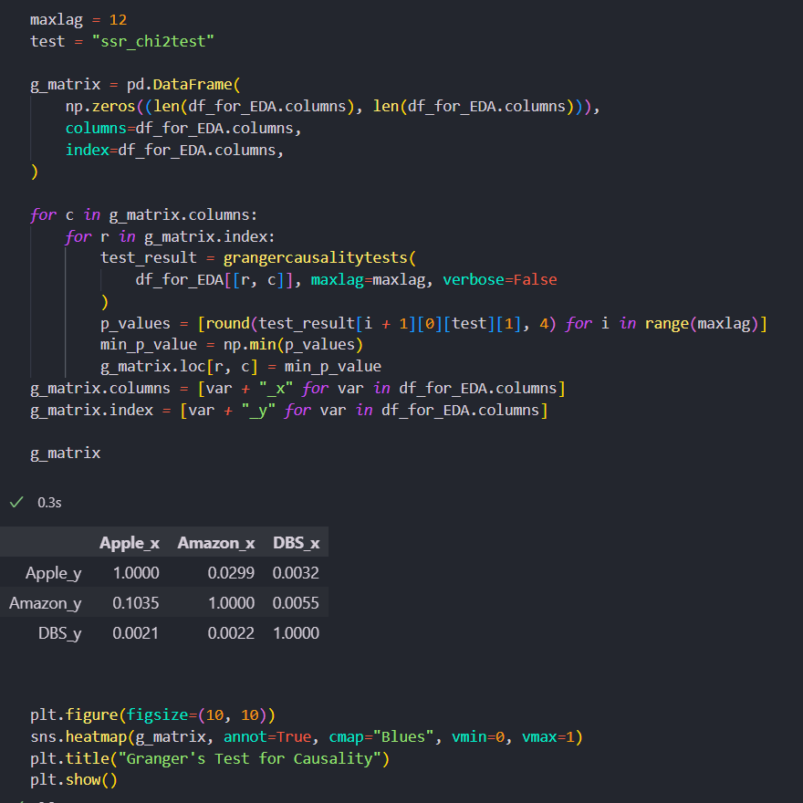
Grangers Test for Causality

Slide 7
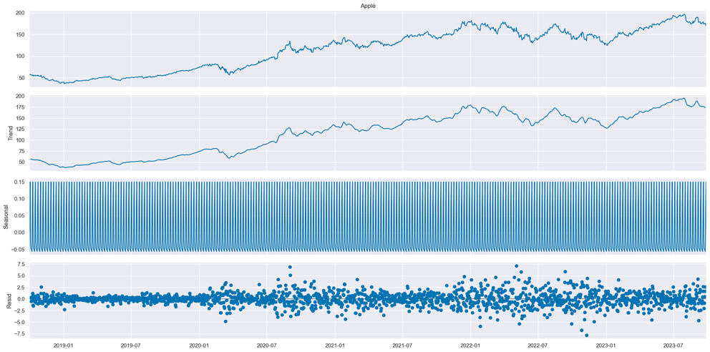
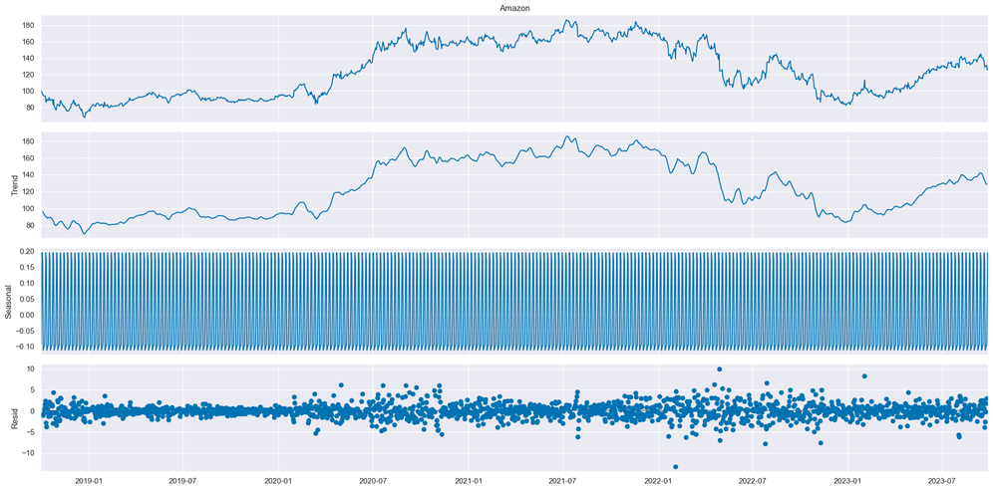
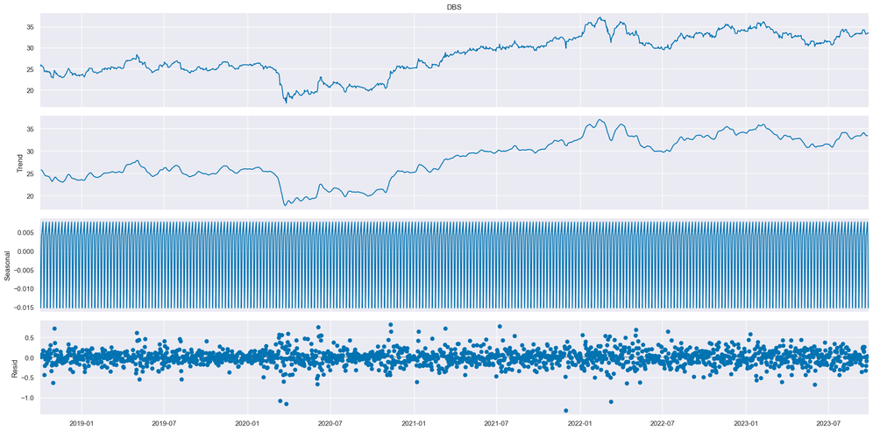
Seasonal Decomposition
Insights to show trend and seasonality of time series dataset, as trends allow of to view patterns.
to capture seasonal patterns, where certain patterns repeat at regular intervals.

Slide 8
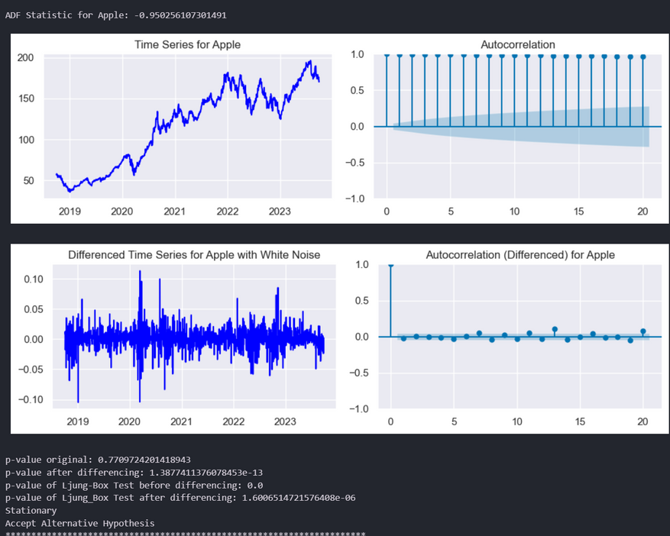
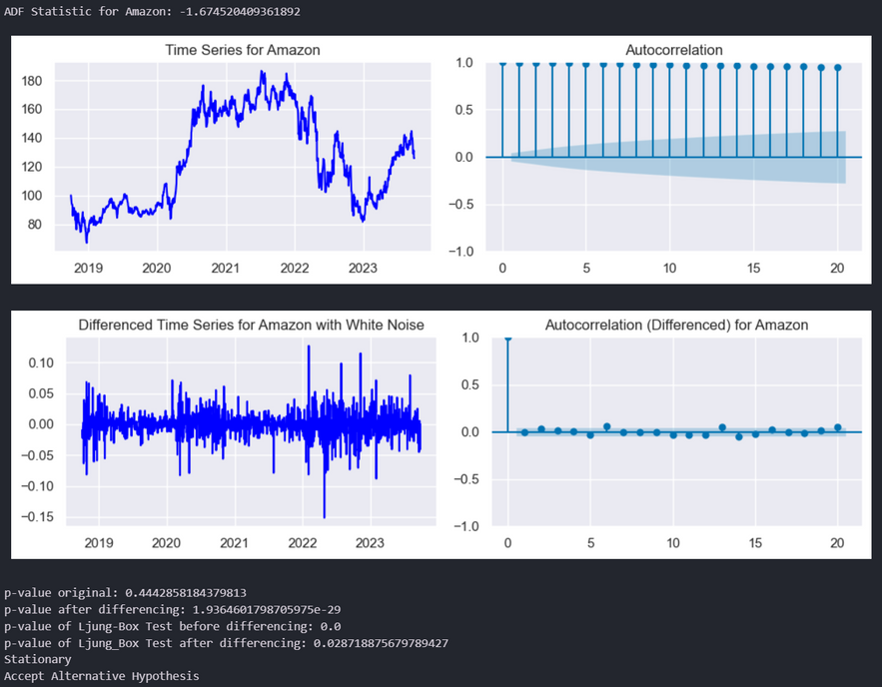
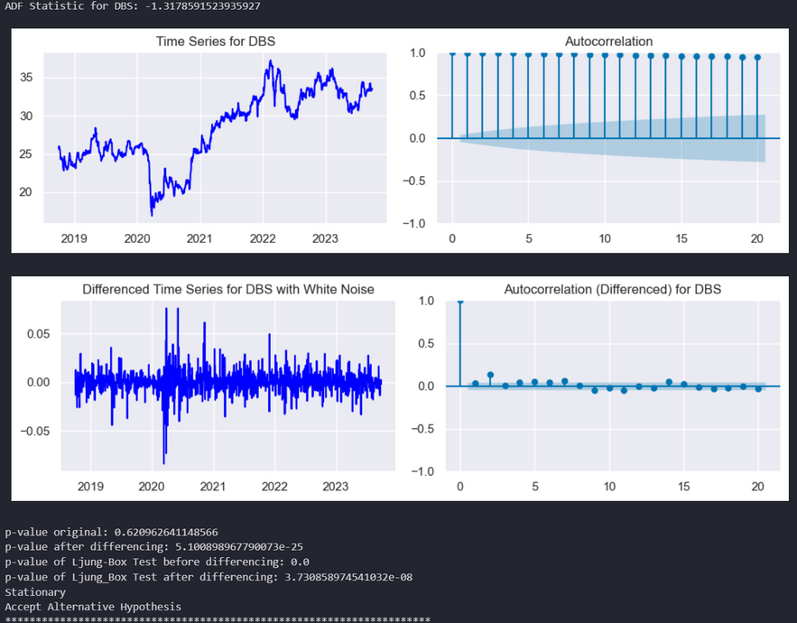
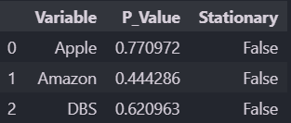
Testing for Stationary and Correlation
H0 : Autocorrelation is zero
H1 : Autocorrelation is not zero
After differencing, the series' autocorrelation is not zero as p-value < 0.05 (Failed to reject the null hypothesis).

Slide 9


Model Training

Slide 10
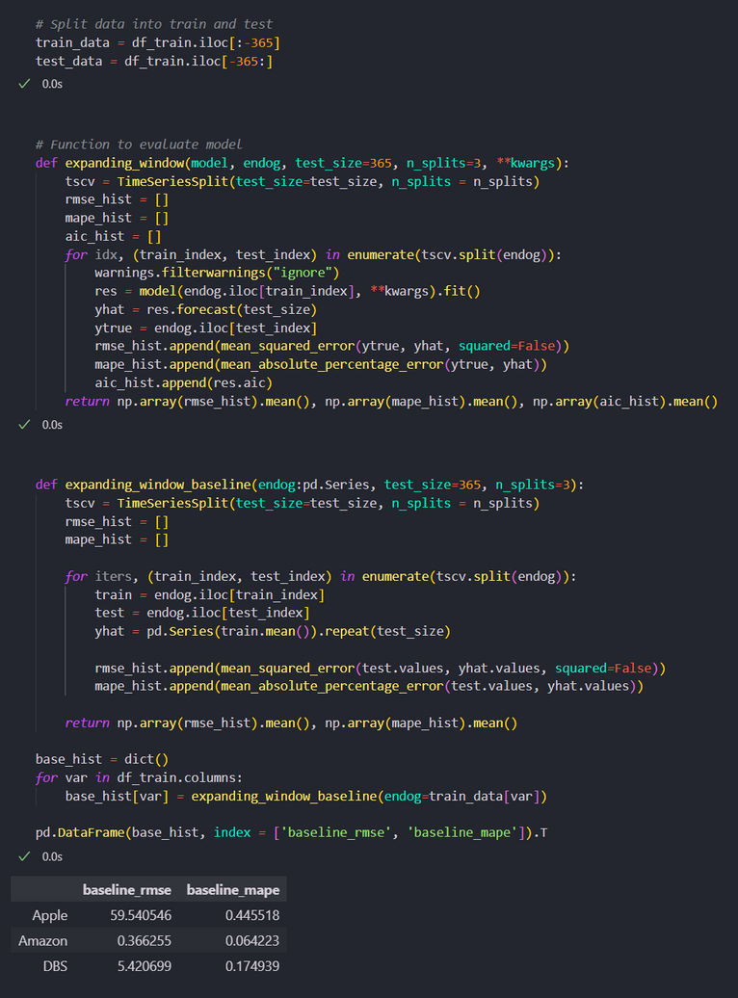
Baseline Model
I have also split our test data to 365 days and train to the rest.
To compare our training model with to ensure the model the performing then a baseline/ random model which will only be roughly 50% Accurate with the RMSE and MSPE scores.

Slide 11

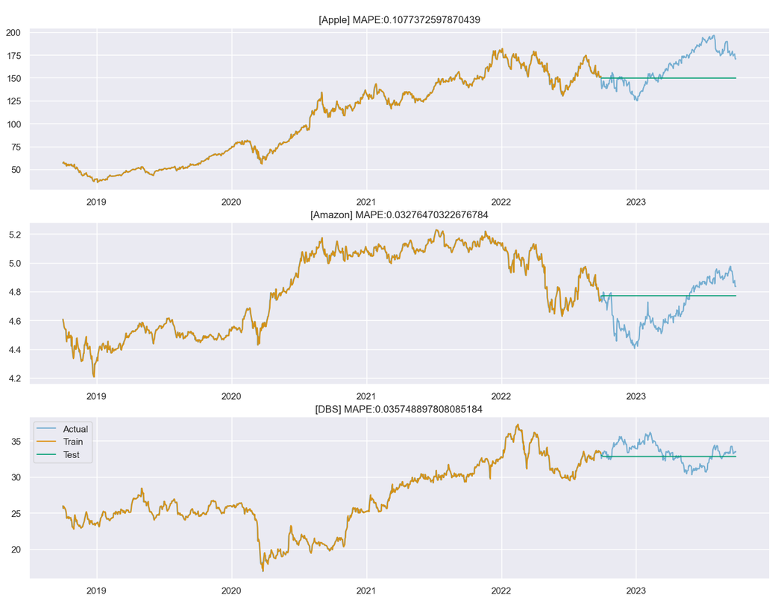

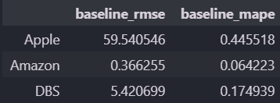
SARIMAX model performance
The SARIMAX model performed pretty well in comparison to the Baseline model. The model predicted better for Apple.
Notes:
Apple scored a baseline of 0.445 MAPE and the model score a 0.107
Amazon scored a baseline of 0.064 MAPE and the model score a 0.032
While DBS Scored a baseline of 0.174 and the model scored a 0.035

Slide 12
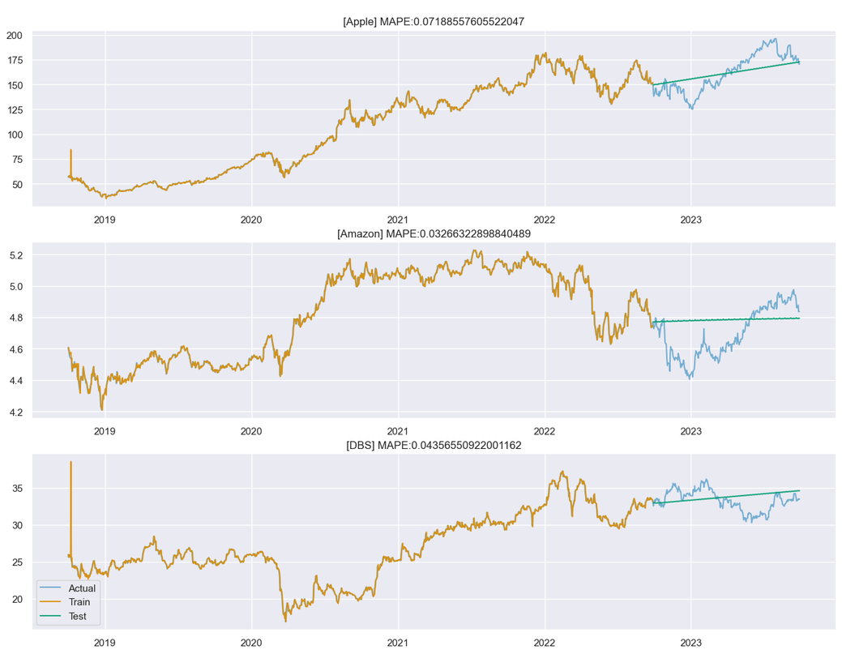
ARIMA Model Performance
This is the Actual, train and test for the ARIMA model for the 3 stocks.
In Comparison to the baseline model , the ARIMA model was able to predict the actual better than the baseline being better than the baseline model.

Slide 13
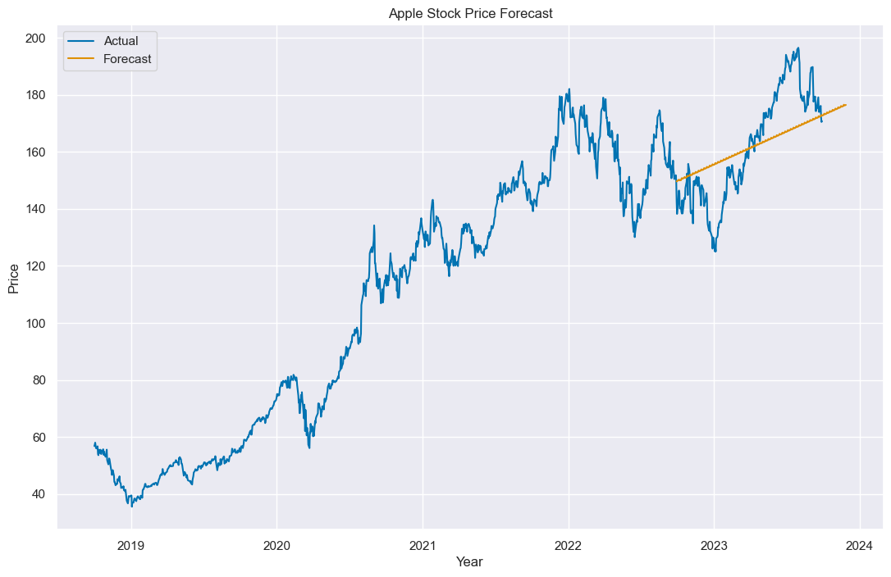
Final Predictions (Apple)

Slide 14
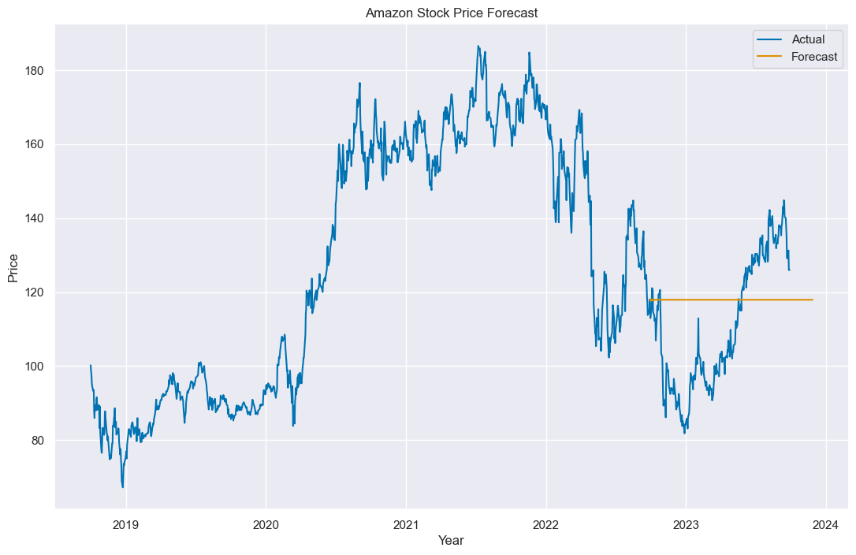
Final Predictions (Amazon)

Slide 15
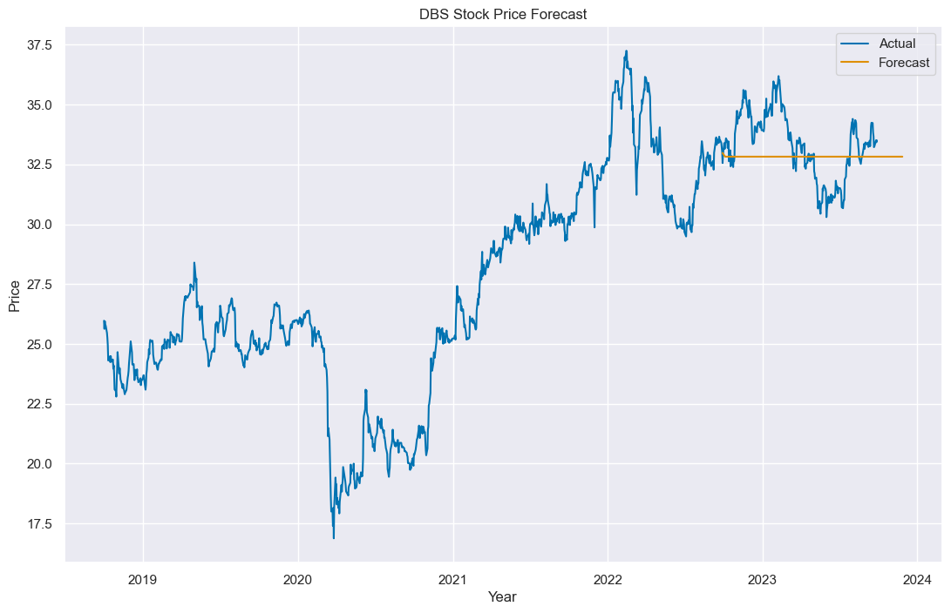
Final Predictions (DBS)

Slide 16
Conclusion
In conclusion my model was able to predict better than the baseline model or the next 60 days on the trend of the stock price by having a lower MSE and MAPE scores. The model's predictions are closer to the actual stock prices than those of the baseline model, both in terms of raw difference (MSE) and percentage difference (MAPE). This indicates that the model is more accurate in predicting the trend of the stock price for the next 60 days compared to the baseline model.
Student_Performance_dataset.csv
CA2.ipynb
CA2-Stock-Price-Data.csv - Data Wrangler
CA2_Clustering.ipynb
CA2.ipynb
Time Series Analysis Project
Univariate Analysis
Final Predictions
fig, axes = plt.figure(figsize=(13,8)), plt.gca()
CA2_Clustering.ipynb
CA2_Clustering.ipynb
Data Preprocessing & Feature Engineering
1. Standard Scaling
kmeans = KMeans(n_clusters=3, random_state=42).fit(tsne_features)
0 3
0
black
Connected to Discord
Prettier
Go Live
Cell 45 of 48
CRLF
Spaces: 4
Ln 4, Col 27
Info: Loading data frame
Sure, I'd be happy to elaborate. The statement is saying that the model in question has performed better than the baseline model in predicting the trend of the stock price for the next 60 days. This conclusion is based on the fact that the model has lower Mean Squared Error (MSE) and Mean Absolute Percentage Error (MAPE) scores. MSE and MAPE are both metrics used to evaluate the performance of predictive models: 1. Mean Squared Error (MSE): This is the average of the squares of the differences between the actual and predicted values. A lower MSE means that the model's predictions are closer to the actual values, which is desirable. 2. Mean Absolute Percentage Error (MAPE): This is the average of the absolute percentage differences between the actual and predicted values. A lower MAPE means that the model's predictions are closer to the actual values in terms of percentage, which is also desirable. So, when the statement says the model has lower MSE and MAPE scores, it means that on average, the model's predictions are closer to the actual stock prices than those of the baseline model, both in terms of raw difference (MSE) and percentage difference (MAPE). This indicates that the model is more accurate in predicting the trend of the stock price for the next 60 days compared to the baseline model.
Code
Markdown
[661]
t_inertia = []
t_score = []
t_centroid = []
t_silhouettes_value = []
for k in range(2, 24):
kmeans = KMeans(n_clusters=k, random_state=1).fit(tsne_features)
label = kmeans.predict(tsne_features)
t_inertia.append(np.sqrt(kmeans.inertia_))
t_centroid.append(kmeans.cluster_centers_)
t_score.append(silhouette_score(tsne_features, label))
t_silhouettes_value.append(silhouette_samples(tsne_features, label))
13.2s
Python
Code
Markdown
[662]
plt.plot(range(2, 24), t_inertia, marker="s")
plt.title("Inertia for each K after Tsne Dimensionality Reduction")
plt.xlabel("$k$")
plt.ylabel("Inertia")
plt.show()
0.2s
Python
Code
Markdown
[663]
plt.plot(range(2, 24), t_score, marker="s")
plt.title("Silhouettes Score after Tsne Dimensionality Reduction")
plt.xlabel("$k$")
plt.ylabel("Silhouette Coefficient")
plt.show()
0.1s
Python
Code
Markdown

Slide 17
Presented By: Rejey Ezekiel (2348935)
Student Performance Clustering-
CA3
AI and Machine Learning ST1511

Slide 18
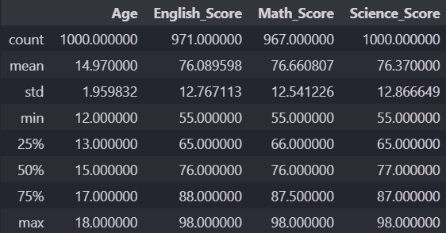
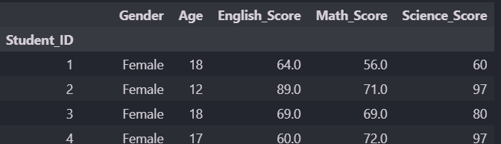
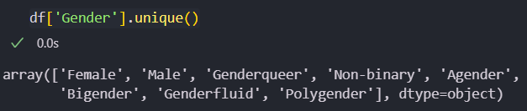
Students Performance Background info
Our datasets gender consisted of more than 2 genders, since we dont know wether this will our clusters, i will retain then but as one hot encoded values.

Slide 19
Exploratory Data Analysis

Slide 20
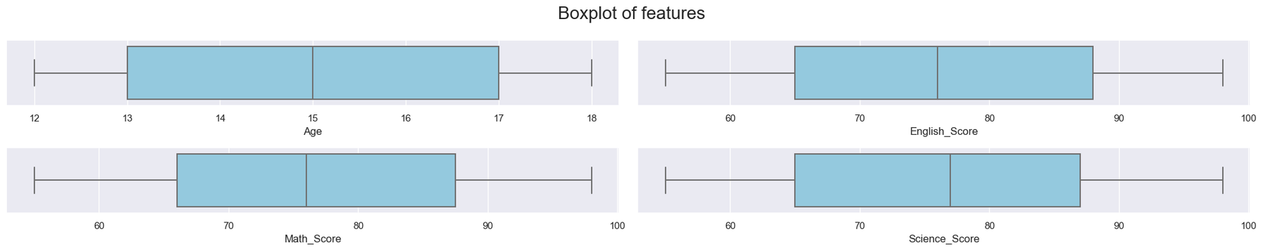
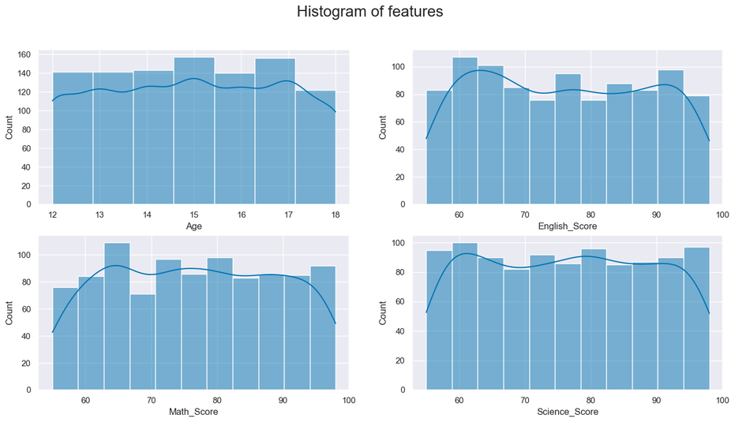
Distribution of Numerical Col
We can see that the distribution of the numerical columns is almost normal having a slight skew with Math score at being most skewed

Slide 21
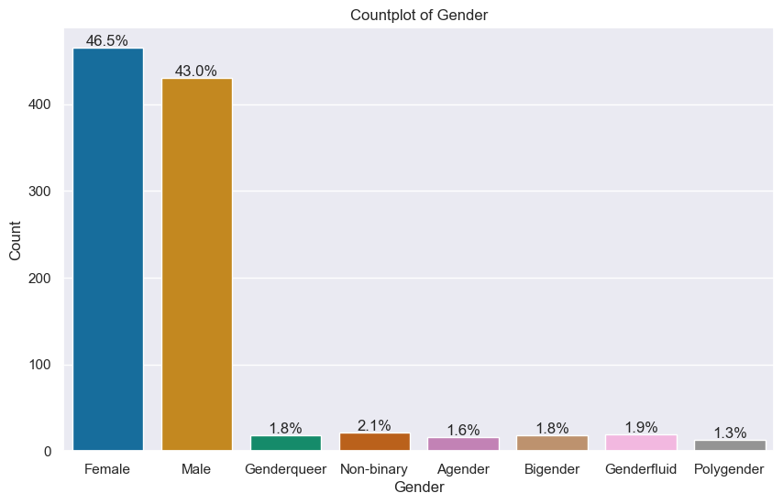
Distribution of Categorical
We can see that the gender column has 8 unique genders, where the majority is male and female.

Slide 22
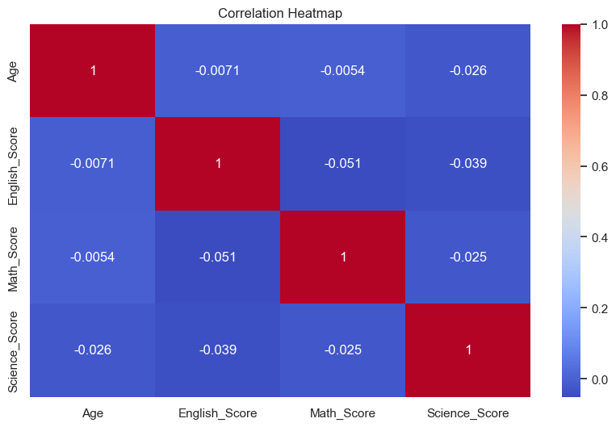
Correlation of the Columns
The correlation between the numerical columns is very low. showing that doing well or better in another subject, affects the other subjects.

Slide 23
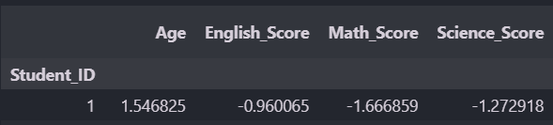
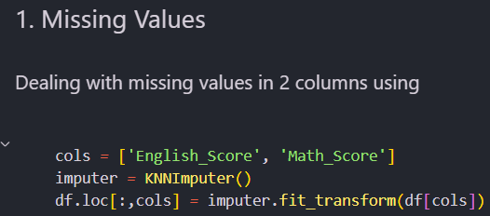
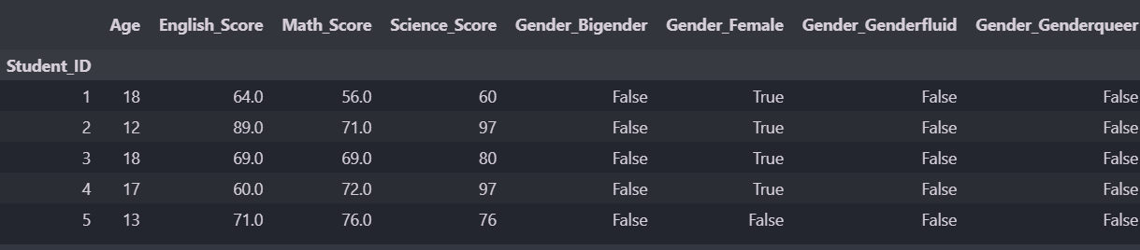
Data Preprocessing & Feature Engineering
Null Values : i use KNN imputer to impute missing values for English and Math columns
Feature Engineering: I have featured engineered a new column called Mean Score with the mean of the 3 subjects. I have also one hot encoded the gender columns to retrieve each unique gender.
Scaling: i have used standard scaler to scale my data to distribute numeric my data.

Slide 24
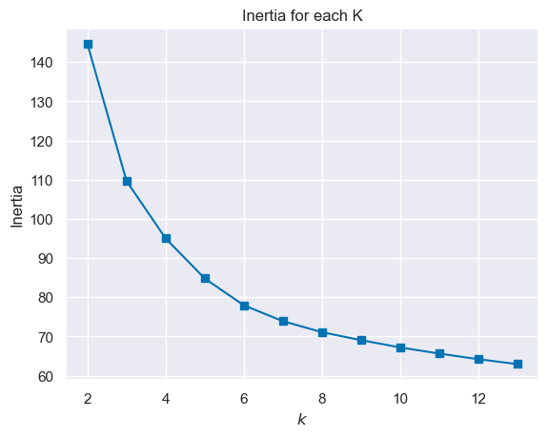
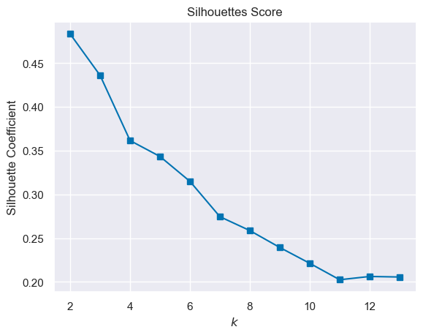
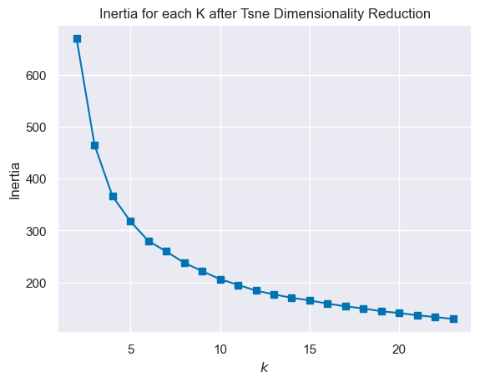
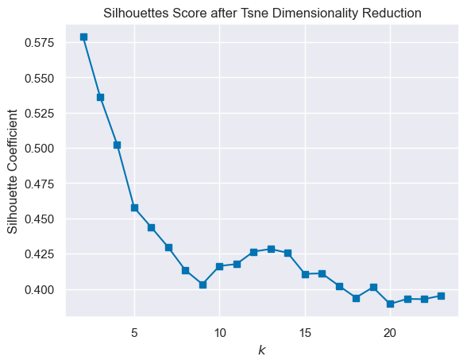
Elbow and Silhouette Before and After Dimensionality Reduction

Slide 25
Model Training

Slide 26
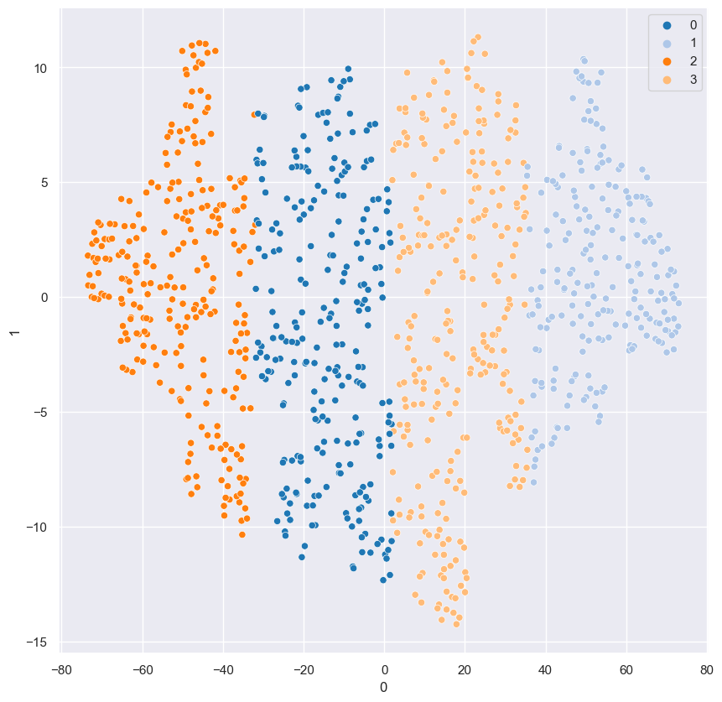
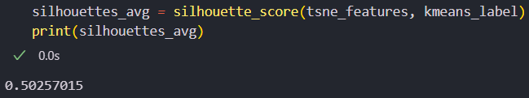
Cluster Testing
Showing good clustering and classification too 4 clusters

Slide 27
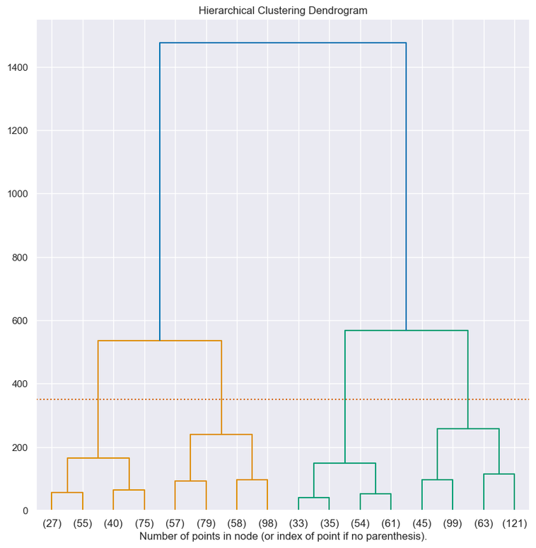
SARIMAX model performance
The Dendrogram shows 4 real clusters where the dotted line intersects the dendrogram

Slide 28
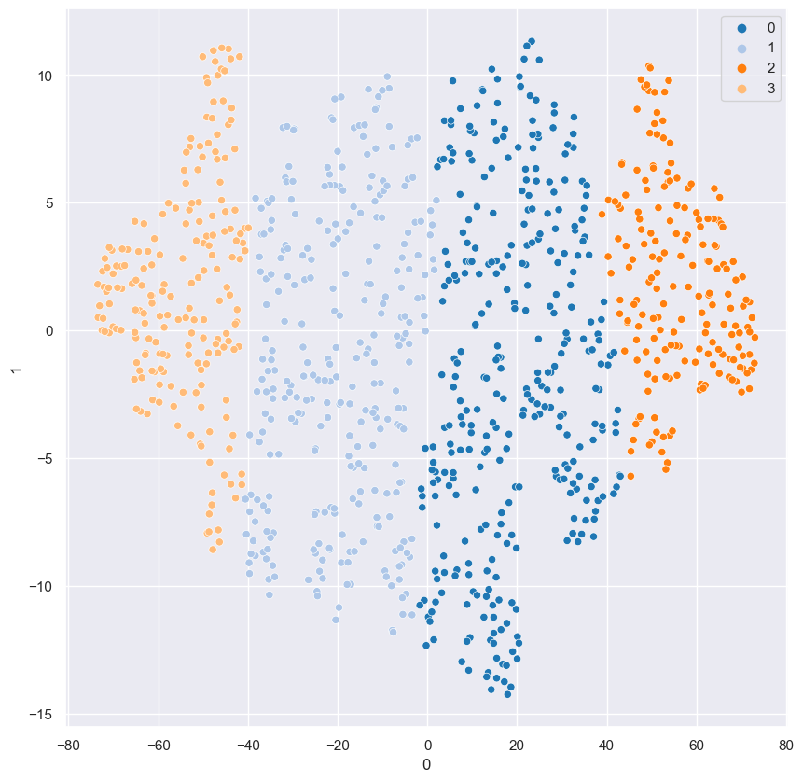
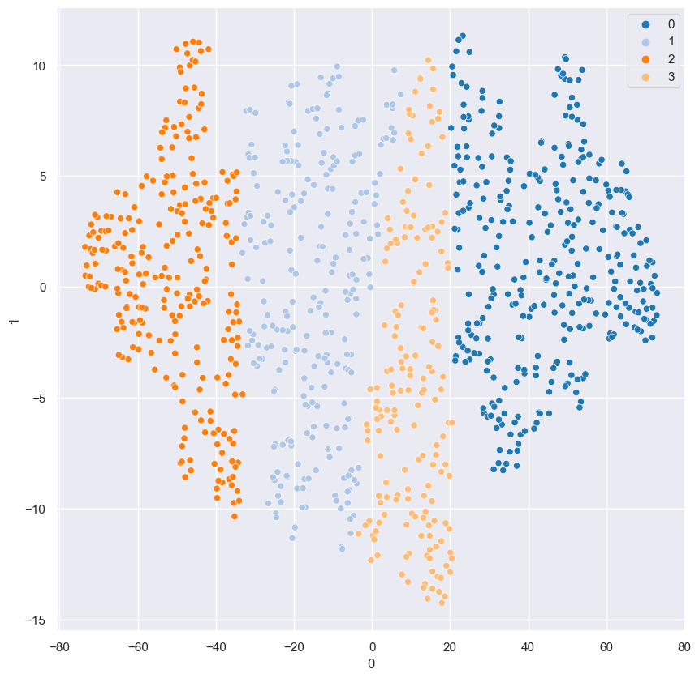
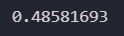
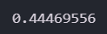
Agglomerative and Spectral Clustering
Agglomerative
Spectral

Slide 29
Chosen Cluster
Highest Silhouette score out of all the 3 clusters. (K - Means)

Slide 30
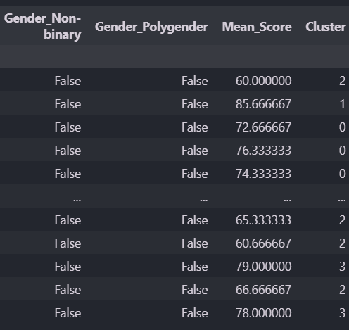
Clustered Dataframe
This is the original dataframe with the clusters added as a new column to identify and plot the results to view the clustering and the observation behind those clustering decesions.

Slide 31
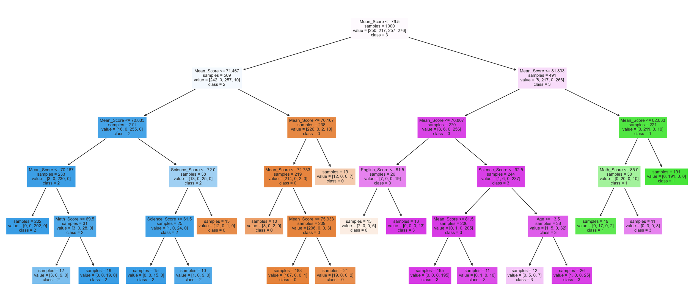
Decision Tree Classifier

Slide 32
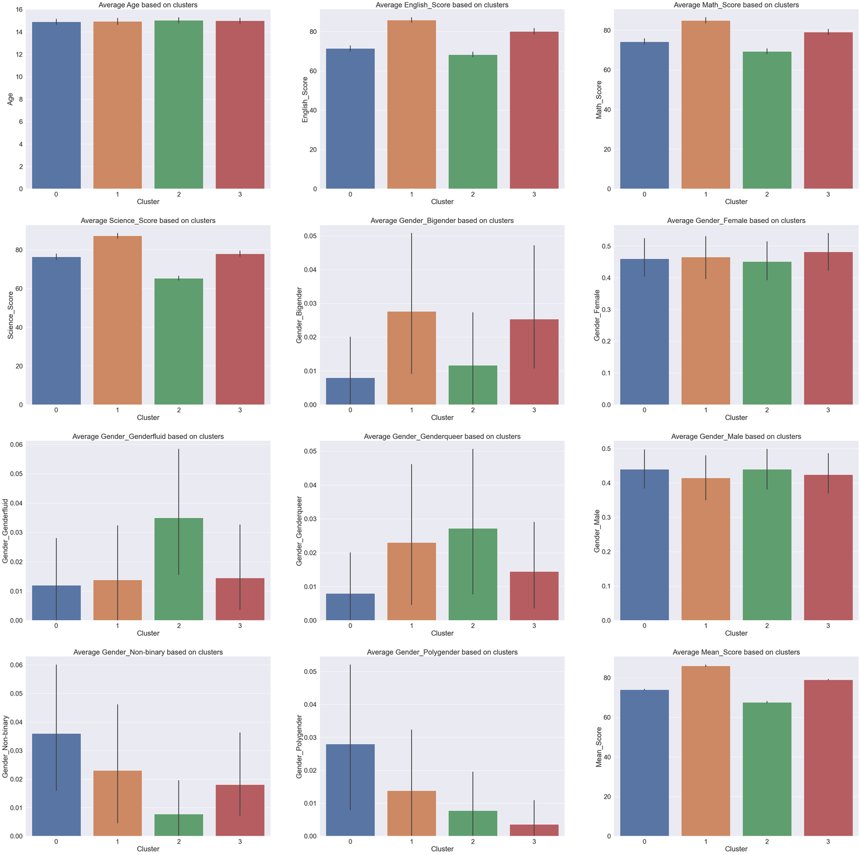
Clusters based on Features

Slide 33
Conclusion
In conclusion all clusters have the same average age, 1 has more highest scoring English, Math and Science Students. All 4 clusters have roughly the same the number of female and males and cluster 1 has the highest average score and cluster 2 has the lowest.
Student_Performance_dataset.csv
CA2.ipynb
CA2-Stock-Price-Data.csv - Data Wrangler
CA2_Clustering.ipynb
CA2.ipynb
Time Series Analysis Project
Univariate Analysis
Final Predictions
fig, axes = plt.figure(figsize=(13,8)), plt.gca()
CA2_Clustering.ipynb
CA2_Clustering.ipynb
Data Preprocessing & Feature Engineering
1. Standard Scaling
kmeans = KMeans(n_clusters=3, random_state=42).fit(tsne_features)
0 3
0
black
Connected to Discord
Prettier
Go Live
Cell 45 of 48
CRLF
Spaces: 4
Ln 4, Col 27
Info: Loading data frame
Sure, I'd be happy to elaborate. The statement is saying that the model in question has performed better than the baseline model in predicting the trend of the stock price for the next 60 days. This conclusion is based on the fact that the model has lower Mean Squared Error (MSE) and Mean Absolute Percentage Error (MAPE) scores. MSE and MAPE are both metrics used to evaluate the performance of predictive models: 1. Mean Squared Error (MSE): This is the average of the squares of the differences between the actual and predicted values. A lower MSE means that the model's predictions are closer to the actual values, which is desirable. 2. Mean Absolute Percentage Error (MAPE): This is the average of the absolute percentage differences between the actual and predicted values. A lower MAPE means that the model's predictions are closer to the actual values in terms of percentage, which is also desirable. So, when the statement says the model has lower MSE and MAPE scores, it means that on average, the model's predictions are closer to the actual stock prices than those of the baseline model, both in terms of raw difference (MSE) and percentage difference (MAPE). This indicates that the model is more accurate in predicting the trend of the stock price for the next 60 days compared to the baseline model.
Code
Markdown
[661]
t_inertia = []
t_score = []
t_centroid = []
t_silhouettes_value = []
for k in range(2, 24):
kmeans = KMeans(n_clusters=k, random_state=1).fit(tsne_features)
label = kmeans.predict(tsne_features)
t_inertia.append(np.sqrt(kmeans.inertia_))
t_centroid.append(kmeans.cluster_centers_)
t_score.append(silhouette_score(tsne_features, label))
t_silhouettes_value.append(silhouette_samples(tsne_features, label))
13.2s
Python
Code
Markdown
[662]
plt.plot(range(2, 24), t_inertia, marker="s")
plt.title("Inertia for each K after Tsne Dimensionality Reduction")
plt.xlabel("$k$")
plt.ylabel("Inertia")
plt.show()
0.2s
Python
Code
Markdown
[663]
plt.plot(range(2, 24), t_score, marker="s")
plt.title("Silhouettes Score after Tsne Dimensionality Reduction")
plt.xlabel("$k$")
plt.ylabel("Silhouette Coefficient")
plt.show()
0.1s
Python
Code
Markdown

Slide 34

Presented by Rejey Ezekiel
Thank you very much!

